Slide 1
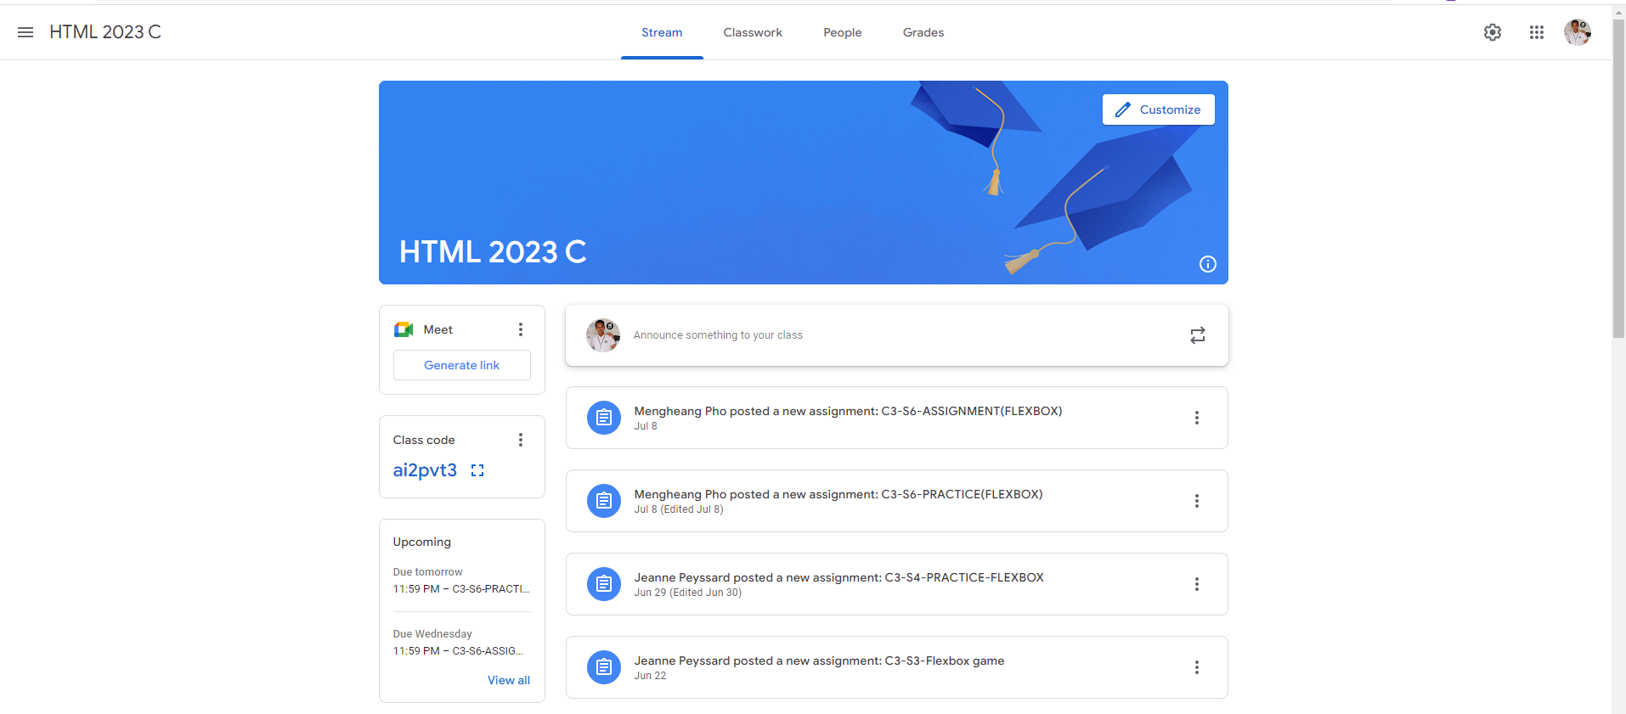
Identify root components of website below

Slide 2
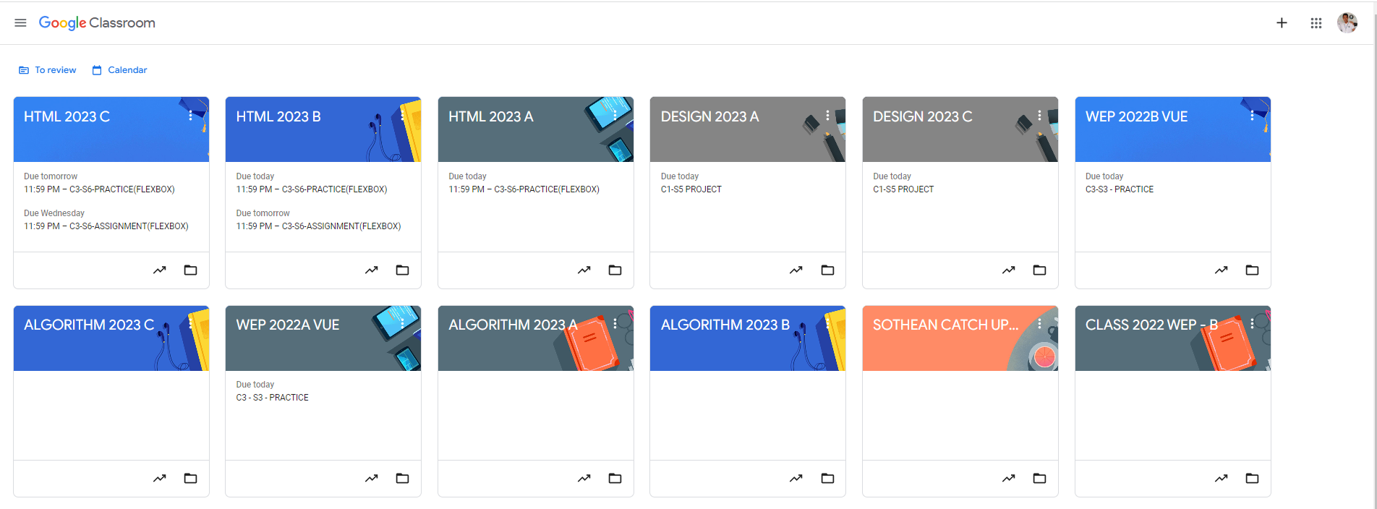
Root div
- Height: 100vh
content
nav
Flex: 0
header
Flex: 0
Flex: 1

Slide 3
In the container it have two div which are Nav and Main

Slide 4
In nav there’re three more container element in it which are Nav-left, Nav-center and Nav-right
In main, it have 2 more container element which are head and main-body.

Slide 5
There are 2 container element in main body which are side-bar on the left and main-content on the right side.
Side bar have three more container element which are meet, class code and up coming.
There are 5 more container element in main content. They are content box and announcement box.

